Slide 1
12. Comparing Groups: Analysis of Variance (ANOVA) Methods
Response y Explanatory x var’s Method
Categorical Categorical Contingency tables (Ch. 8,15)
(chi-squared, etc., logistic regr.)
Quantitative Quantitative Regression and correlation
(Ch 9 bivariate, 11 multiple regr.)
Quantitative Categorical ANOVA (Ch. 12)
(Where does Ch. 7 on comparing 2 means or 2 proportions fit into this?)
Ch. 12 compares the mean of y for the groups corresponding to the categories of the categorical explanatory var’s (factors).
Examples:
y = mental impairment, x’s = treatment type, gender, marital status
y = income, x’s = race, education (<HS, HS, college), type of job

Slide 2
Comparing means across categories of one classification (1-way ANOVA)
Let g = number of groups
We’re interested in inference about the population means
μ₁ , μ₂ , ... , μ_{g}
The analysis of variance (ANOVA) is an F test of
H₀: μ₁ = μ₂ = ⋅⋅⋅ = μ_{g}
H_{a}: The means are not all identical
The test analyzes whether the differences observed among the sample means could have reasonably occurred by chance, if H₀ were true (due to R. A. Fisher).

Slide 3
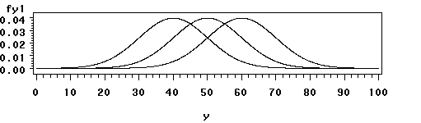
One-way analysis of variance
Assumptions for the F significance test :
  The g population dist’s for the response variable are normal
  The population standard dev’s are equal for the g groups (σ)
  Randomization, such that samples from the g populations can be treated as independent random samples
  (separate methods used for dependent samples)

Slide 4
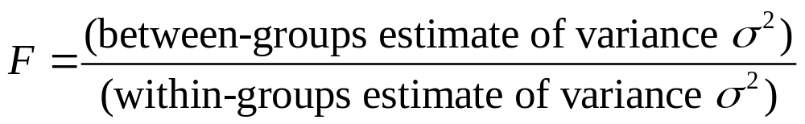
Variability between and within groups
(Picture of two possible cases for comparing means of 3 groups; which gives more evidence against H₀?)
The F test statistic is large (and P-value is small) if variability between groups is large relative to variability within groups
Both estimates unbiased when H₀ is true
(then F tends to fluctuate around 1 according to F dist.)
Between-groups estimate tends to overestimate variance when H₀ false (then F is large, P-value = right-tail prob. small)

Slide 5
Detailed formulas later, but basically
Each estimate is a ratio of a sum of squares (SS) divided by a df value, giving a mean square (MS).
The F test statistic is a ratio of the mean squares.
P-value = right-tail probability from F distribution (almost always the case for F and chi-squared tests).
Software reports an “ANOVA table” that reports the SS values, df values, MS values, F test statistic, P-value. (Looks like ANOVA table for regression.)

Slide 6
Exercise 12.12: Does number of good friends depend on happiness? (GSS data)
Very happy Pretty happy Not too happy
Mean 10.4 7.4 8.3
Std. dev. 17.8 13.6 15.6
n 276 468 87
Do you think the population distributions are normal?
A different measure of location, such as the median, may be more relevant. Keeping this in mind, we use these data to illustrate one-way ANOVA.

Slide 7
ANOVA table
Sum of Mean
Source squares df square F Sig
Between-groups 1627 2 813 3.47 0.032
Within-groups 193901 828 234
Total 195528 830
The mean squares are 1627/2 = 813 and 193901/828 = 234.
The F test statistic is the ratio of mean squares, 813/234 = 3.47
If H₀ true, F test statistic has the F dist with df₁ = 2, df₂ = 828, and P(F ≥ 3.47) = 0.032. There is quite strong evidence that the population means differ for at least two of the three groups.

Slide 8
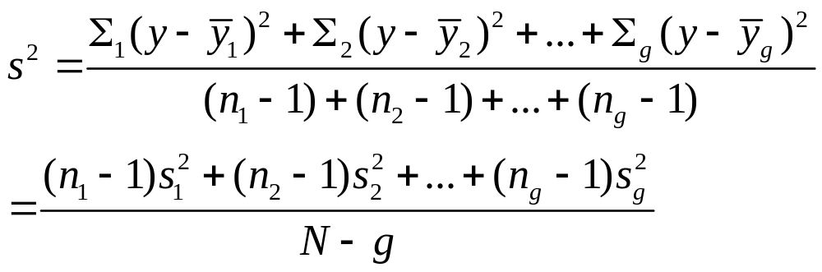
Within-groups estimate of variance
g = number of groups
Sample sizes n₁ , n₂ , … , n_{g ,}, N = n₁ + n₂ + … + n_{g}
This pools the g separate sample variance estimates into a single estimate that is unbiased, regardless of whether H₀ is true. (With equal n’s, s² is simple average of sample var’s.)
The denominator, N – g, is df₂ for the F test.

Slide 9
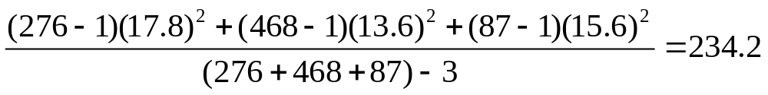

For the example, this is
which is a mean square error (MSE). Its square root,
s = 15.3, is the pooled standard deviation estimate that summarizes the separate sample standard deviations of 17.8, 13.6, 15.6 into a single estimate.
(Analogous “pooled estimate” used for two-sample comparisons in Chapter 7 that assumed equal variance.)
Its df value is (276 + 468 + 87) – 3 = 828. This is df₂ for F test, because the estimate s² is in denominator of F statistic.

Slide 10
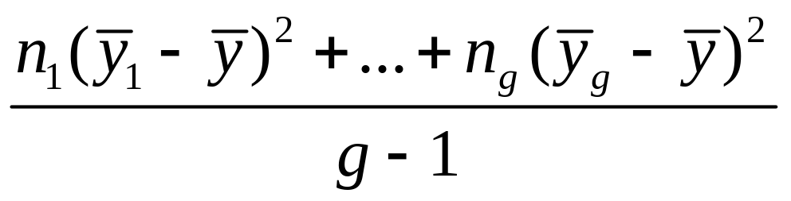

Between-groups estimate of variance where is the sample mean for the combined samples. (Can motivate using variance formula for sample means, as described in Exercise 12.57.)
Since this describes variability among g groups, its df = g – 1, which is df₁ for the F test (since between-groups estimate goes in numerator of F test statistic).
For the example, between-groups estimate = 813, with df = 2, which is df₁ for the F test.

Slide 11
Some comments about the ANOVA F test
F test is robust to violations of normal population assumption, especially as sample sizes grow (CLT)
F test is robust to violations of assumption of equal population standard deviations, especially when sample sizes are similar
When sample sizes small and population distributions may be far from normal, can use the Kruskal-Wallis test, a nonparametric method.
Can implement with software such as SPSS (next)
Why use F test instead of several t tests?

Slide 12
Doing a 1-way ANOVA with software
Example: Data in Exercise 12.6. You have to do something similar on HW in 12.8(c).
Quiz scores in a beginning French course
Mean Standard deviation
Group A: 4, 6, 8 6.0 2.0
Group B: 1, 5 3.0 2.8
Group C: 9, 10, 5 8.0 2.6
Report hypotheses, test stat, df values, P-value, interpret

Slide 13
ANOVA table
Sum of Mean
Source squares df square F Sig
Between-groups 30.0 2 15.0 2.5 0.177
Within-groups 30.0 5 6.0
Total 60.0 7
If H₀: μ₁ = μ₂ = μ₃ were true, probability would equal 0.177 of getting F test statistic value of 2.5 or larger. This is not much evidence against the null. It is plausible that the population means are identical.
(But, not much power with such small sample sizes)

Slide 14
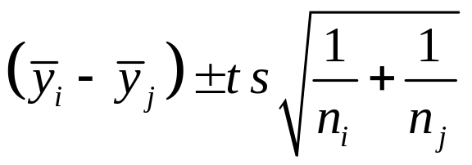

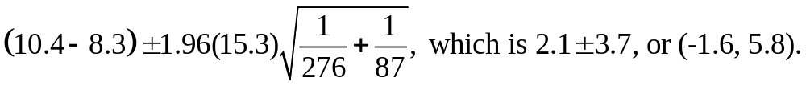
Follow-up Comparisons of Pairs of Means
A CI for the difference (µ_{i} -µ_{j}) is
where t-score is based on chosen confidence level, df = N – g for t-score is df₂ for F test, and s is square root of MSE (within-groups estimate from ANOVA table).
Example: A 95% CI for difference between population mean number of close friends for those who are very happy and not too happy is (taking s = 15.3)

Slide 15
(very happy, pretty happy): 3.0 ± 2.3
(not too happy, pretty happy): 0.9 ± 3.5
The only pair of groups for whom we can conclude the population mean number of friends differ is “very happy” and “pretty happy”.
i.e., this conclusion corresponds to the summary:
µ_{PH} µ_{NTH} µ_{VH}
________
_________ (note lack of “transitivity” when dealing
in probabilistic comparisons)

Slide 16
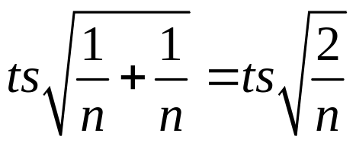
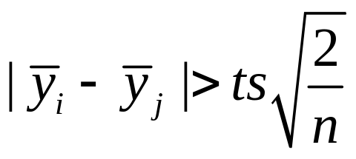
Comments about comparing pairs of means
In designed experiments, often n₁ = n₂ = … = n_{g} = n (say), and then the margin of error for each comparison is
For each comparison, the CI comparing the two means does not contain 0 if
That margin of error called the “least significant difference” (LSD)

Slide 17
If g is large, the number of pairwise comparisons,
which is g(g-1)/2,
is large. The probability may be unacceptably large that at least one of the CI’s is in error.
Example: For g = 10, there are 45 comparisons.
With 95% CIs, just by chance we expect about 45(0.05) = 2.25 of the CI’s to fail to contain the true difference between population means.
(Similar situation in any statistical analysis making lots of inferences, such as conducting all the t tests for  parameters in a multiple regression model with a large number of predictors)

Slide 18
Multiple Comparisons of Groups
Goal: Obtain confidence intervals for all pairs of group mean difference, with fixed probability that entire set of CI’s is correct.
One solution: Construct each individual CI with a higher confidence coefficient, so that they will all be correct with at least 95% confidence.
The Bonferroni approach does this by dividing the overall desired error rate by the number of comparisons to get error rate for each comparison.

Slide 19
Example: With g = 3 groups, suppose we want the “multiple comparison error rate” to be 0.05. i.e., we want 95% confidence that all three CI’s contain true differences between population means, 0.05 = probability that at least one CI is in error.
Take 0.05/3 = 0.0167 as error rate for each CI.
Use t = 2.39 instead of t = 1.96 (large N, df)
Each separate CI has form of 98.33% CI instead of 95% CI. Since 2.39/1.96 = 1.22, the margins of error are about 22% larger
(very happy, not too happy): 2.1 ± 4.5
(very happy, pretty happy): 3.0 ± 2.8
(not too happy, pretty happy): 0.9 ± 4.3

Slide 20
Comments about Bonferroni method
Based on Bonferroni’s probability inequality:
For events E₁ , E₂ , E₃ , …
P(at least one event occurs) ≤ P(E₁ ) + P(E₂ ) + P(E₃ ) + …
Example: E_{i} = event that ith CI is in error, i = 1, 2, 3.
With three 98.67% CI’s,
P(at least one CI in error) ≤ 0.0167 + 0.0167 + 0.0167 = 0.05
Software also provides other methods, such as Tukey multiple comparison method, which is more complex but gives slightly shorter CIs than Bonferroni.

Slide 21
Regression Approach To ANOVA
Dummy (indicator) variable: Equals 1 if observation from a particular group, 0 if not.
With g groups, we create g - 1 dummy variables:
e.g., for g = 3,
z₁ = 1 if observation from group 1, 0 otherwise
z₂ = 1 if observation from group 2, 0 otherwise
Subjects in last group have all dummy var’s = 0
Regression model: E(y) = α + β₁z₁ + β₂z₂
Mean for group 1: μ₁ = α + β₁ group 2: μ₂ = α + β₂
Mean for group 3: μ₃ = α
Regression coefficients β₁ = μ₁ – μ₃ and β₂ = μ₂ – μ₃ compare each mean to mean for last group

Slide 22

Example: Model E(y) = α + β₁z₁+ β₂z₂
where
y = reported number of close friends
z₁ = 1 if very happy, 0 otherwise (group 1, mean 10.4)
z₂ = 1 if pretty happy, 0 otherwise (group 2, mean 7.4)
z₁ = z₂ = 0 if not too happy (group 3, mean 8.3)
The prediction equation is = 8.3 + 2.1z₁ - 0.9z₂
Which gives predicted means
Group 1 (very happy): 8.3 + 2.1(1) - 0.9(0) = 10.4
Group 2 (pretty happy): 8.3 + 2.1(0) - 0.9(1) = 7.4
Group 3 (not too happy): 8.3 + 2.1(0) - 0.9(0) = 8.3

Slide 23
Test Comparison (ANOVA, regression)
μ₁ = α + β₁ μ₂ = α + β₂ μ₃ = α
1-way ANOVA: H₀: μ₁= μ₂ =μ₃
Regression approach: Testing H₀: β₁ = β₂ = 0 gives the ANOVA F test (same df values, P-value)
F test statistic from regression (H₀: β₁ = β₂ = 0) is
F = (MS for regression)/MSE

Slide 24
Regression ANOVA table:
Sum of Mean
Source Squares df square F Sig
Regression 1627 2 813 3.47 0.032
Residual 193901 828 234
Total 195528 830
The ANOVA “between-groups SS” is the “regression SS”
The ANOVA “within-groups SS” is the “residual SS” (SSE)
Regression t tests: Test whether means for groups 1 and 2 are significantly different from group 3:
  H₀: β₁ = 0 corresponds to H₀: μ₁ – μ₃ = 0
  H₀: β₂ = 0 corresponds to H₀: μ₂ – μ₃ = 0

Slide 25
Let’s use SPSS to do regression for data in Exercise 12.6
Predicted quiz score = 8.0 - 2.0z₁ – 5.0z₂
Recall sample means were 6, 3, 8 for groups 1, 2, 3, which this prediction equation generates.
Note regression F = 2.5, P-value = 0.177 is same as before (p. 13 of notes) with 1-way ANOVA

Slide 26
Why use regression to perform ANOVA?
Unify various methods as special case of one analysis
e.g. even methods of Chapter 7 for comparing two means can be viewed as special case of regression with a single dummy variable as indicator for group
E(Y) = α + βz with z=1 in group 1, z=0 in group 2
so E(Y) = α + β in group 1, E(Y) = α in group 2,
difference between population means = β
Being able to handle categorical variables in a regression model gives us a way to model several predictors that may be categorical or (more commonly, in practice) a mixture of categorical and quantitative.

Slide 27
Two-way ANOVA
Analyzes relationship between quantitative response y and two categorical explanatory factors.
Example (Exercise 7.50): A sample of college students were rated by a panel on their physical attractiveness. Response equals number of dates in past 3 months for students rated in top or bottom quartile of attractiveness, for females and males.
(Journal of Personality and Social Psychology, 1995)

Slide 28
Summary of data: Means (standard dev., n)
Gender
Attractiveness Men Women
More 9.7 (s =10.0, n = 35) 17.8 (s = 14.2, n = 33)
Less 9.9 (s = 12.6, n = 36) 10.4 (s = 16.6, n = 27)
We consider first the various hypotheses and significance tests for two-way ANOVA, and then see how it is a special case of a regression analysis.

Slide 29
“Main Effect” Hypotheses
A main effect hypothesis states that the means are equal across levels of one factor, within levels of the other factor.
H₀ : no effect of gender, H₀ : no effect of attractiveness
Example of population means for number of dates in past 3 months satisfying these are:
1. No gender effect 2. No attractiveness effect
Gender Gender
Attractiveness Men Women Men Women
More 14.0 14.0 10.0 14.0
Less 10.0 10.0 10.0 14.0

Slide 30
ANOVA tests about main effects
Same assumptions as 1-way ANOVA (randomization, normal population dist’s with equal standard deviations in each “group” which is a “cell” in the table)
There is an F statistic for testing each main effect (some details on next page, but we’ll skip this).
Estimating sizes of effects more naturally done by viewing as a regression model (later)
But, testing for main effects only makes sense if there is not strong evidence of interaction between the factors in their effects on the response variable.

Slide 31
Tests about main effects continued (but we skip today)
The test statistic for a factor main effect has form
F = (MS for factor)/(MS error),
a ratio of variance estimates such that the numerator tends to inflate (F tends to be large) when H₀ false.
s = square root of MSE in denominator of F is estimate of population standard deviation for each group
df₁ for F statistic is (no. categories for factor – 1). (This is number of parameters that are coefficients of dummy variables in the regression model corresponding to 2-way ANOVA.)

Slide 32
Interaction in two-way ANOVA
Testing main effects only sensible if there is “no interaction”; i.e., effect of each factor is the same at each category for the other factor.
Example of population means
1. satisfying no interaction 2. showing interaction
Gender Gender
Attractiveness Men Women Men Women
More 12.0 14.0 12.0 14.0
Less 9.0 11.0 9.0 6.0
(see graph and “parallelism” representing lack of interaction)
We can test H₀ : no interaction with F = (interaction MS)/(MS error)
Should do so before considering main effects tests

Slide 33
What do the sample means suggest?
Gender
Attractiveness Men Women
More 9.7 17.8
Less 9.9 10.4
This suggests interaction, with cell means being approx. equal except for more attractive women (higher), but authors report “none of the effects was significant, due to the large within-groups variance” (data probably also highly skewed to right).

Slide 34
An example for which we have the raw data: Student survey data file
y = number of weekly hours engaged in sports and other physical exercise.
Factors: gender, whether a vegetarian (both categorical, so two-way ANOVA relevant)
We use SPSS with survey.sav data file
On Analyze menu, recall Compare means option has 1-way ANOVA as a further option
Something weird in SPSS: levels of factor must be coded numerically, even though treated as nominal variables in the analysis!
For gender, I created a dummy variable g for gender
For vegetarian, I created a dummy variable v for vegetarianism

Slide 35
Sample means on sports by factor:
Gender: 4.4 females (n = 31), 6.6 males (n = 29)
Vegetarianism: 4.0 yes (n = 9), 5.75 no (n = 51)
One-way ANOVA comparing mean on sports by gender has F = 5.2, P-value = 0.03.
One-way ANOVA comparing mean on sports by whether a vegetarian has F = 1.57, P-value = 0.22.
These are merely squares of t statistic from Chapter 7 for comparing two means assuming equal variability
(df for t is n₁ + n₂ – 2 = 58 = df₂ for F test, df₁ = 1)

Slide 36
One-way ANOVA’s handle only one factor at a time, give no information about possible interaction, how effects of one factor may change according to level of other factor
Sample means
Vegetarian Men Women
Yes 3.0 (n = 3) 4.5 (n = 6)
No 7.0 (n = 26) 4.4 (n = 25)
Seems to show interaction, but some cell n’s are very small and standard errors of these means are large (e.g., SPSS reports se = 2.1 for sample mean of 3.0)
In SPSS, to do two-way ANOVA, on Analyze menu choose General Linear Model option and Univariate suboption, declaring factors as fixed (I remind myself by looking at Appendix p. 552 in my SMSS textbook).

Slide 37
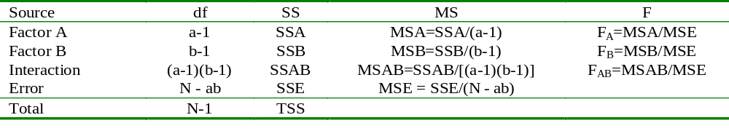
Two-way ANOVA Summary
General Notation: Factor A has a levels, B has b levels
Procedure:
  Test H₀: No interaction based on the F_{AB} statistic
  If the interaction test is not significant, test for Factor A and B effects based on the F_{A} and F_{B} statistics (and can remove interaction terms from model)

Slide 38
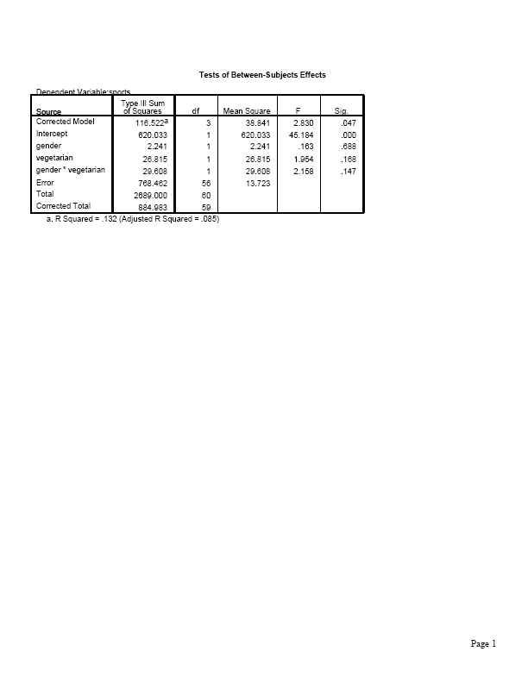
Test of H₀ : no interaction has
F = 29.6/13.7 = 2.16,
df₁ = 1, df₂ = 56, P-value = 0.15

Slide 39
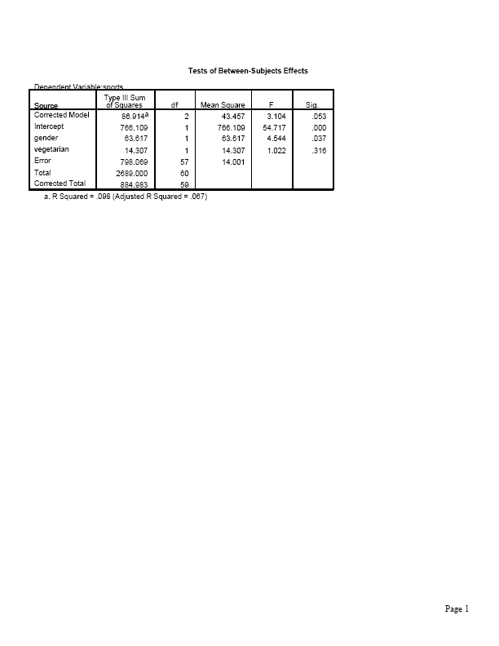
Since interaction is not significant, we can take it out of model and re-do analysis using only main effects.
(In SPSS, click on Model to build customized model containing main effects but no interaction term)
At 0.05 level, gender is significant (P-value = 0.037) but vegetarianism is not (P-value = 0.32)

Slide 40
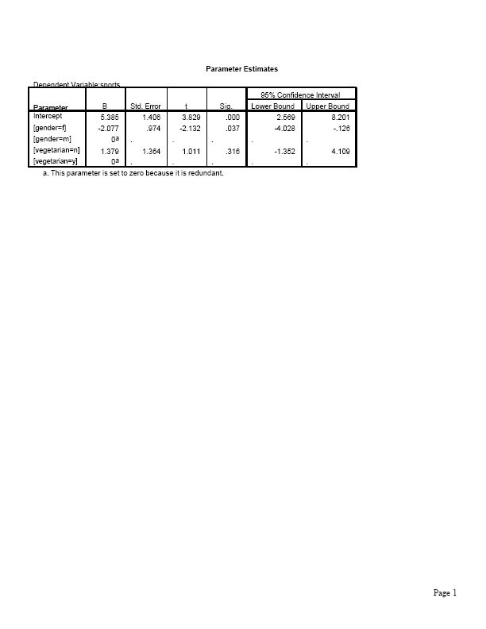
More informative to estimate sizes of effects using regression model with dummy variables g for gender (1=female, 0=male), v for vegetarian (1=no, 0=yes).
Model E(y) = α + β₁g + β₂v
Model satisfies lack of interaction
To allow interaction, we add β₃(v*g) to model

Slide 41
Predicted weekly hours in sports = 5.4 – 2.1g + 1.4v
The estimated means are:
5.4 for male vegetarians (g = 0, v = 0)
5.4 – 2.1 = 3.3 for female vegetarians (g = 1, v = 0)
5.4 + 1.4 = 6.8 for male nonvegetarians (g=0, v =1)
5.4 – 2.1 + 1.4 = 4.7 for female nonveg. (g=1, v=1)
These “smooth” the sample means and display no interaction (recall mean = 3.0 for male vegetarians had only n = 3).
Sample means Model predicted means
Vegetarian Men Women Men Women
Yes 3.0 4.5 5.4 3.3
No 7.0 4.4 6.8 4.7

Slide 42
The “no interaction” model provides estimates of main effects and CI’s
Estimated vegetarian effect (comparing mean sports for nonveg. and veg.), controlling for gender, is 1.4.
Estimated gender effect (comparing mean sports for females and males), controlling for whether a vegetarian, is -2.1.
Controlling for whether a vegetarian, a 95% CI for the difference between mean weekly time on sports for males and for females is
2.077 ± 2.00(0.974), or (0.13, 4.03)
(Note 2.00 is t score for df = 57 = 60 - 3)

Slide 43
Comments about two-way ANOVA
If interaction terms needed in model, need to compare means (e.g., with CI) for levels of one factor separately at each level of other factor
Testing a term in the model corresponds to a comparison of two regression models, with and without the term. The SS for the term is the difference between SSE without and with the term (i.e., the variability explained by that term, adjusting for whatever else is in the model). This is called a partial SS or a Type III SS in some software

Slide 44
The squares of the t statistics shown in the table of parameter estimates are the F statistics for the main effects (Each factor has only two categories and one parameter, so df₁ = 1 in F test)
When cell n’s are identical, as in many designed experiments, the model SS for model with factors A and B and their interaction partitions exactly into
Model SS = SS_{A} + SS_{B} + SS_{AxB}
and SS_{A} and SS_{B} are same as in one-way ANOVAs or in two-way ANOVA without interaction term. (Then not necessary to delete interaction terms from model before testing main effects)
When cell n’s are not identical, estimated difference in means between two levels of a factor in two-way ANOVA need not be same as in one-way ANOVA (e.g., see our example, where vegetarianism effect is 1.75 in one-way ANOVA where gender ignored, 1.4 in two-way ANOVA where gender is controlled)
Two-way ANOVA extends to three-way ANOVA and, generally, factorial ANOVA.

Slide 45
For dependent samples (e.g., “repeated measures” over time), there are alternative ANOVA methods that account for the dependence (Sections 12.6, 12.7). Likewise, the regression model for ANOVA extends to models for dependent samples.
The model can explicitly include a term for each subject. E.g., for a crossover study with t = treatment (1, 0 dummy var.) and p_{i} = 1 for subject i and p_{i} = 0 otherwise, assuming no interaction,
E(y) = α + β₁p₁+ β₂ p₂ + … + β_{n-1} p_{n-1} + β_{n} t
The number of “person effects” can be huge. Those effects are usually treated as “random effects” (random variables, with some distribution, such as normal) rather than “fixed effects” (parameters). The main interest is usually in the fixed effects.

Slide 46
In making many inferences (e.g., CI’s for each pair of levels of a factor), multiple comparison methods (e.g., Bonferroni, Tukey) can control overall error rate.
Regression model for ANOVA extends to models having both categorical and quantitative explanatory variables (Chapter 13)
Example: Modeling y = number of close friends, with predictors
g =gender (g = 1, female, g = 0 male),
race (r₁ = 1, black, 0 other; r₂ = 1, Hispanic, 0 other,
r₁ = r₂ = 0, white)
x₁ = number of social organizations a member of
x₂ = age
Model E(y) = α + β₁g+ β₂ r₁ + β₃ r₂ + β₄ x₁ + β₅ x₂

Slide 47
How do we do regression when response variable is categorical (Ch. 15)?
Model the probability for a category of the response variable. E.g., with binary response (y = 1 or 0), model P(y = 1) in terms of explanatory variables.
Need a mathematical formula more complex than a straight line, to keep predicted probabilities between 0 and 1
Logistic regression uses an S-shaped curve that goes from 0 up to 1 or from 1 down to 0 as a predictor x changes

Slide 48
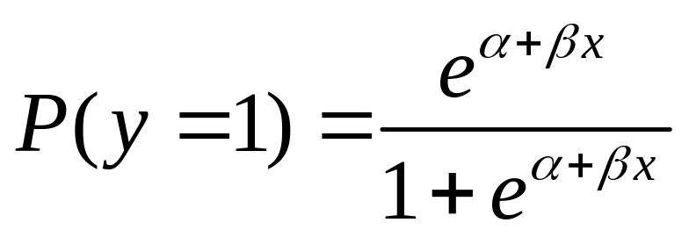
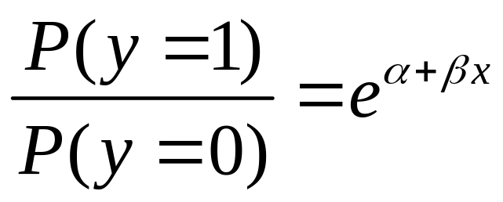
Logistic regression model
With binary response (y = 1 or 0) and a single explanatory variable, model has form
Then the odds satisfies
(exponential function) and odds multiplies by e for each 1-unit increase in x; i.e., e is an odds ratio
i.e., the odds for y = 1 instead of y = 0 at x+1 divided by odds at x.

Slide 49
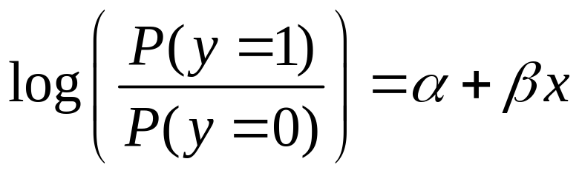
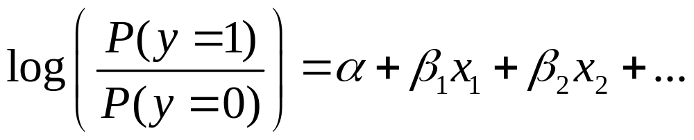
For this model, taking the log of the odds yields a linear equation in x,
The log of the odds is called the “logit,” and this type of model is sometimes called a logit model.
This logistic regression model extends to many predictors

Slide 50
As in ordinary regression, it’s possible to have quantitative and categorical explanatory variables (using dummy variables for categorical ones).
Example: For sample of elderly, y = whether show symptoms of Alzheimer’s disease (1 = yes, 0 = no)
x₁ = score on test of mental acuity
x₂ = physically mobile (1 = yes, 0 = no)
A model without an interaction term implies “parallel S-shaped curves” when fix one predictor, consider effect of other predictor
A model with interaction implies curves have different rate of change (picture)

Slide 51
Binary logistic regression extends also to
logistic regression for nominal responses
logistic regression for ordinal responses
logistic regression for multivariate responses, such as in longitudinal studies (need to then account for samples being dependent, such as by using random effects for subjects in the model)
Details in my book,
An Introduction to Categorical Data Analysis
(2nd ed., 2007, published by Wiley)

Slide 52
Some ANOVA review questions
Why is it called analysis of “variance”?
How do the between-groups and within-groups variability affect the size of the one-way ANOVA F test statistic?
Why do we need the F dist. (instead of just using the t dist.)? In what sense is the ANOVA F test limited in what it tells us?
When and why is it useful to use a multiple comparison method to construct follow-up confidence intervals?
You want to compare 4 groups. How can you do this using regression? Show how to set up dummy variables, give the regression equation, and show how the ANOVA null hypothesis relates to a regression null hypothesis.
Suppose a P-value = 0.03. Explain how to interpret this for a 1-way ANOVA F test comparing several population means.
Give an example of population means for a two-way ANOVA that satisfy (a) no main effect, (b) no interaction.

Slide 53
Stat 101 review of topic questions
Chapter 2: Why is random sampling in a survey and randomization in an experiment helpful? What biases can occur with other types of data (such as volunteer sampling on the Internet).
Chapter 3: How can we describe distributions by measures of the center (mean, median) and measures of variability (standard deviation)? What is empirical rule, effect of extreme skew?
Chapter 4: Why is the normal distribution important? What is a sampling distribution, and why is it important? What does the Central Limit Theorem say?

Slide 54
Chapter 5: What is a CI, and how to interpret it? (Recall we use normal dist. for inference about proportions, t distribution for inference about means)
Chapter 6: What are the steps of a significance test? How do we interpret a P-value? What are limitations of this method (e.g., statistical vs. practical significance, no info about size of effect)
Chapter 7: How can we compare two means or compare two parameters (e.g., interpret a CI for a difference)? Independent vs. dependent samples
Chapter 8: When do we analyze contingency tables? For a contingency table, what does the hypothesis of independence mean, how do we test it? What can we do besides chi-squared test? (standardized residuals, measure strength of association)

Slide 55
Chapter 9: When are regression and correlation used? How interpret correlation and r-squared? How test independence?
Chapter 10: In practice, why is important to consider other variables when we study the effect of an explanatory var. on a response var.? Why can the nature of an effect change after controlling some other variable? (Recall Simpson’s paradox)
Chapter 11: How to interpret a multiple regression equation? Interpret multiple correlation R and its square. Why do we need an F test?
Chapter 12: What is the ANOVA F test used for?
Recall ANOVA review questions 3 pages back.

Slide 56
Congratulations, you’ve (almost) made it to the end of Statistics 101!
Projects next Wednesday, 9-11:30 and 1-3:30, here
Final exam: Monday, December 20, 9-12 am
CGIS South. S-010 lecture hall
Covers entire course, but strongest emphasis on
Chapters 9-12 on regression, multiple regression, ANOVA
Be prepared to explain concepts, interpretations
Formula sheet to be posted at course website
Review pages for entire course at course website
Office hours for Thursday and Friday before exam (to be posted at course website), and please e-mail us with questions.
Thanks to Jon and Roee for their excellent TF help!
Thanks to all of you for your hard work!
and best of luck with the rest of your time at Harvard!!

